Slide 1
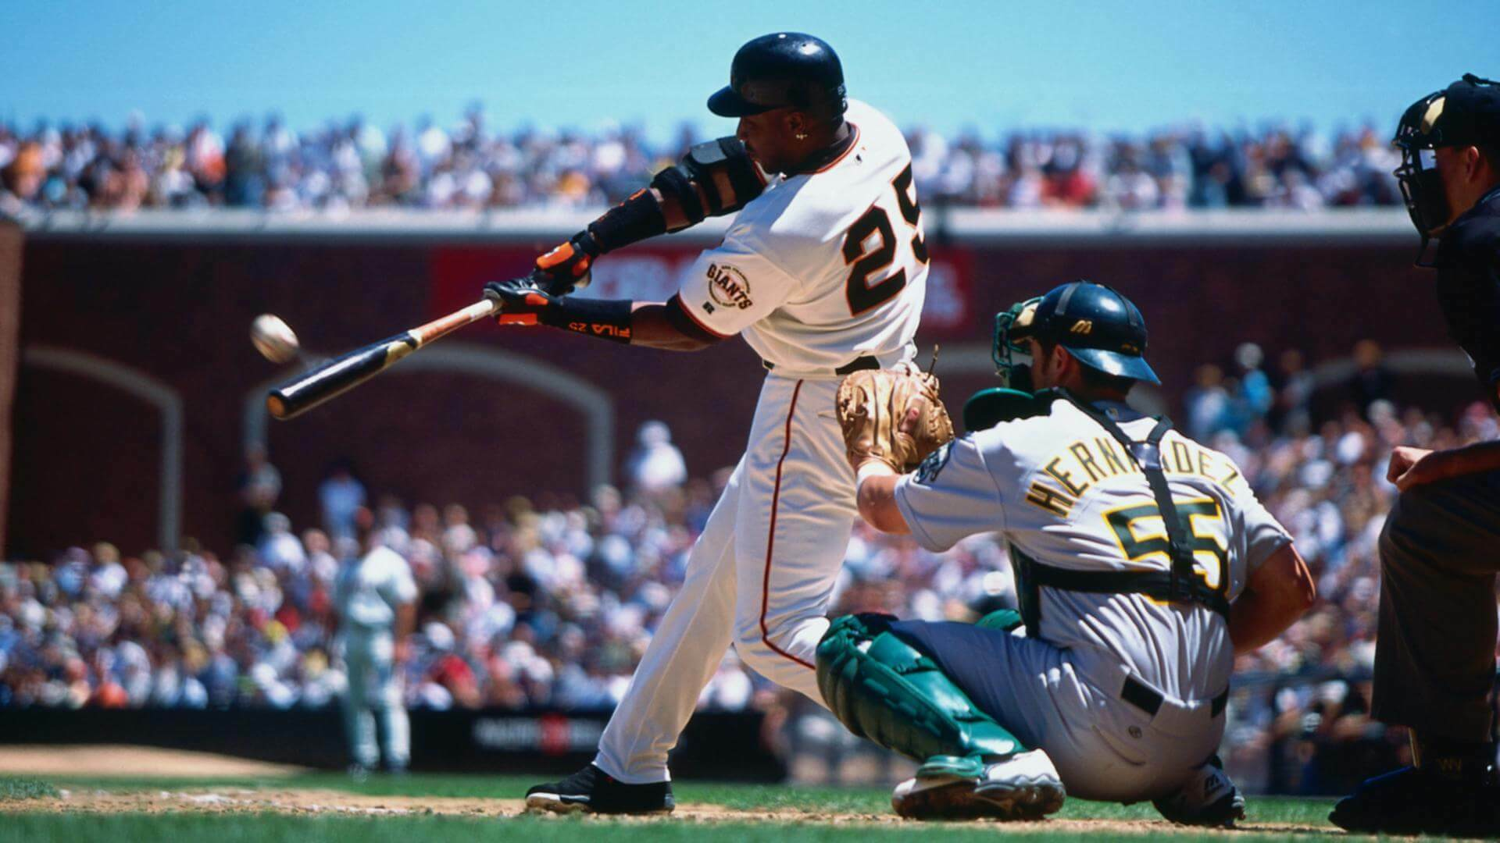
More machine learning with MLB statistics
Dec 19, 2024
Matthew Cavanaugh
IOD Project 3

Slide 2

Data source and background
https://stathead.com/baseball/
Baseball Reference contains detailed statistics on all levels of professional and college baseball stretching as far back as 1871 (full play-by-play data on all MLB games since 1952). Parent company Sports Reference also operates Basketball Reference, Pro Football Reference, and many others.
Stathead is a subscription-based service which offers deeper analysis of the Sports Reference database with more advanced metrics and sorting options.
The dataset we are using in this lab only considers players who have hit at least 100 Home Runs (to exclude pitchers), and retired no later than 2018 (due to Hall of Fame eligibility rules). There are 803 such players.
Couldn’t find a way to have Hall of Fame included directly with the other statistics, so ended up having to create two separate datasets and combine them.

Slide 3
Data caveats and limitations
There is some dispute as to what qualifies as a Major League, especially pre-1901. Some accepted modern teams were previously in leagues that have since disbanded, and some legendary players spent part or all of their careers with teams that no longer exist. I used every league that Stathead judges to be major.
Older data are incomplete, especially for the Negro Leagues, where many barnstorming games were played for which there is little or no information available.
Hall of Fame induction is not based on objective statistics, but is voted on by the Baseball Writers' Association of America (BBWAA), whose motivations are often opaque and shift over time. Some players with impressive statistics are excluded for non-statistical reasons (more on that in the next slide). Additionally, some players with unimpressive playing careers later achieve fame through coaching or management.

Slide 4
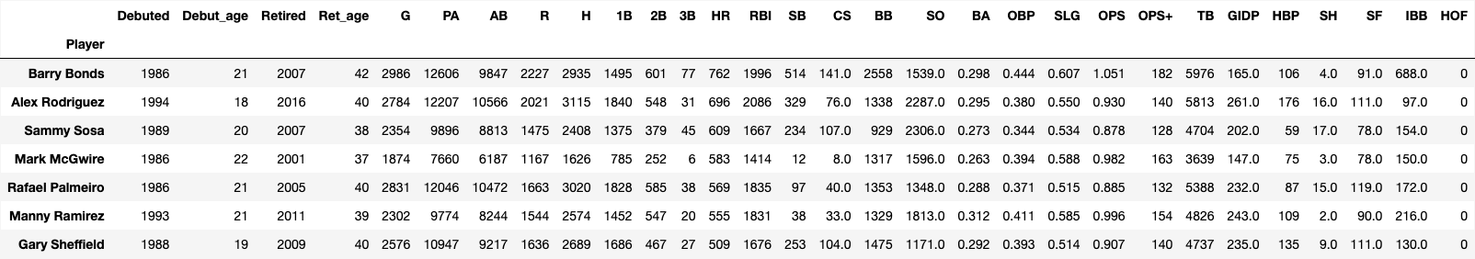
Controversial Hall of Fame exclusions
Barry Bonds, the all-time leader in home runs, is not in the Hall of Fame despite that achievement. In fact, of the 26 eligible players in this dataset who have hit at least 500 home runs, 7 have been excluded. All seven have been accused of or admitted to use performance-enhancing drugs. Here they are below.
Additionally, the all-time leader in hits, Pete Rose, was banned from baseball for life after admitting to gambling on games he played in.
Let’s see how the models handle these unusual cases.

Slide 5
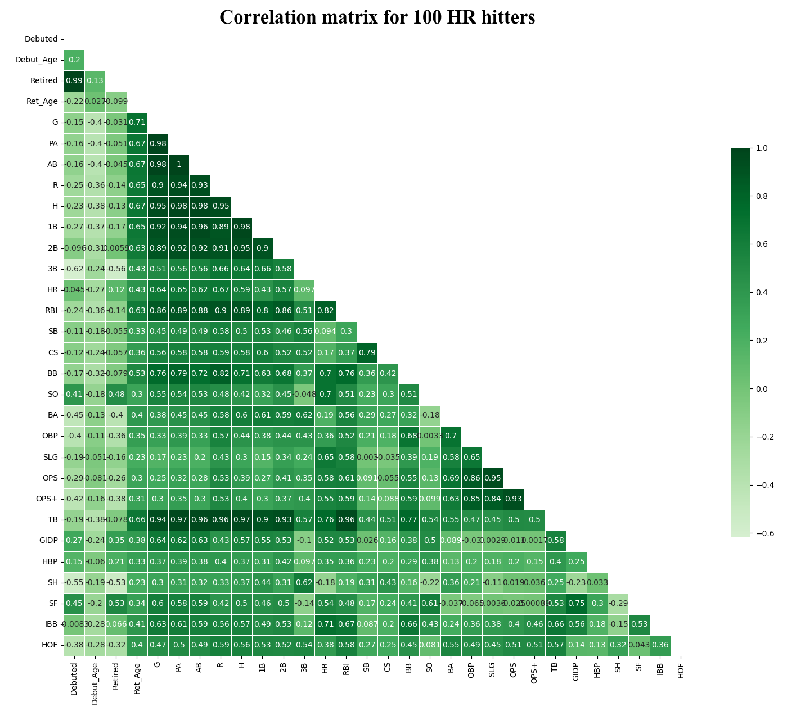
Correlation
matrix

Slide 6
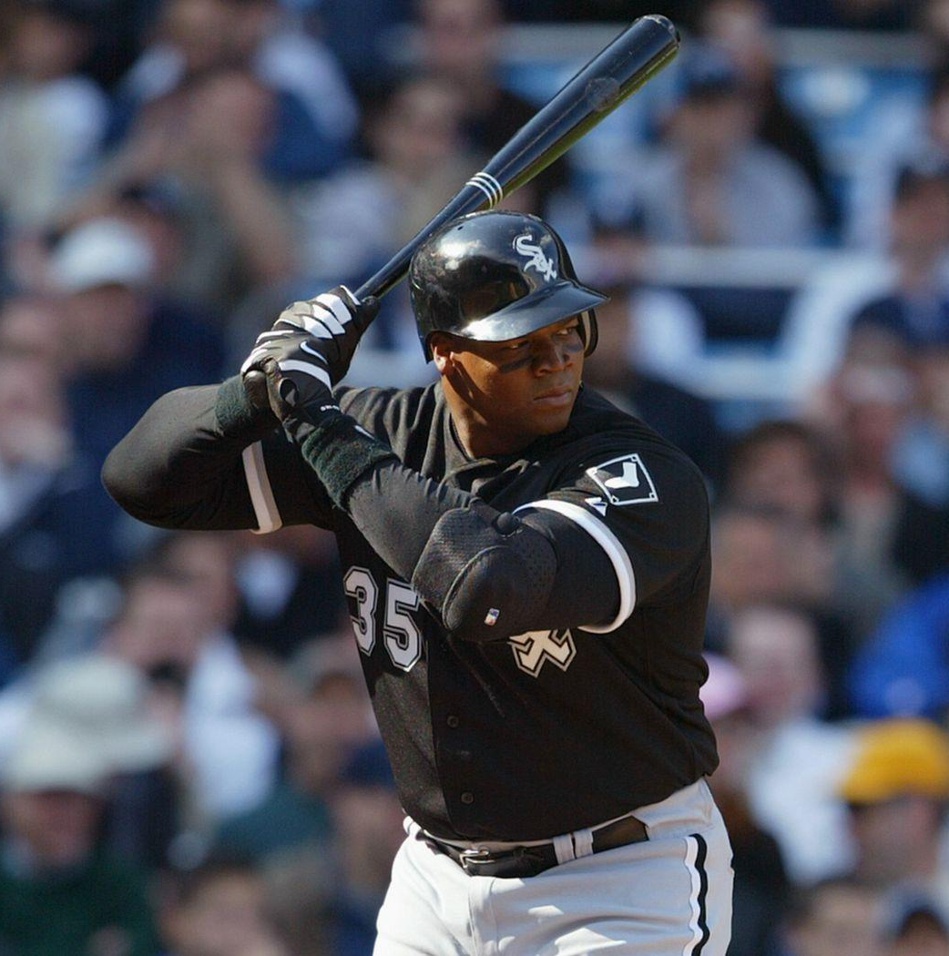
Part 1: Binary classification
Using two binary machine learning models - Support Vector Classifier and Random Forest Classifier - how accurately can we predict whether each player was named to the National Baseball Hall of Fame?

Slide 7
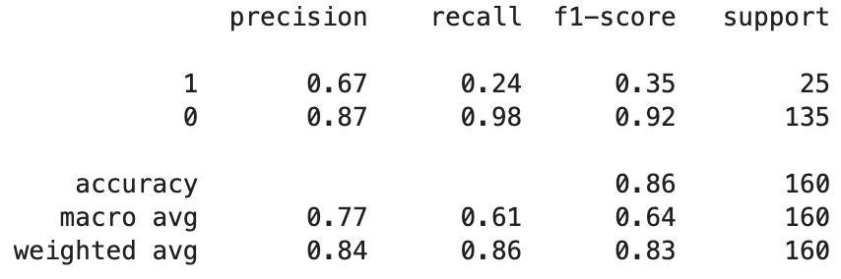
Model 1: Support Vector Classifier
First, I defined a train_test_split with a test size 80%, defined X as “HOF” and y as all other columns. Just to see what would happen, I fit an SVC model with no hyperparameters defined. It returned the following classification report:
86% accuracy isn’t the worst, though it could certainly be improved. But 24% recall is very bad! You may recall this was the primary recurring problem on my previous project. Let’s try to fix it.

Slide 8
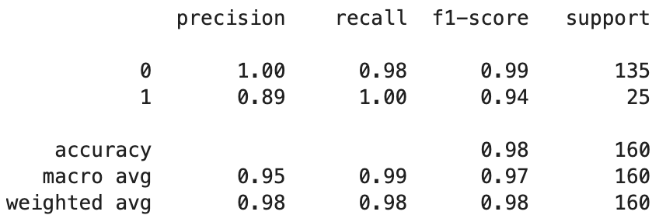
Model 1: Support Vector Classifier
I ran a GridSearchCV with five folds on 50 candidates to find the best possible accuracy, precision, and recall scores on the training dataset. All three agreed on the same parameters and returned the following summary report:
Much better!
With my new parameters chosen, I used them to define and fit a new model:
svc = SVC(C=1, gamma=1.0, kernel='linear', probability=False)

Slide 9
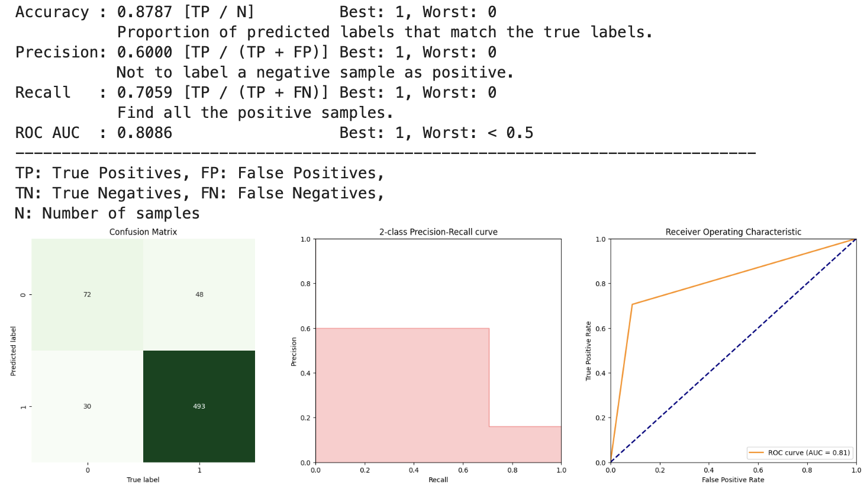
Model 1: Support Vector Classifier
Test summary report
72 true positives
48 false positives
30 false negatives
493 true negatives
It seems the model was somewhat overfitting to the training data, as the recall dropped from near-perfect to only about 70%. That’s still better than any model I tried last time. However, the improvement in recall came at the cost of lower precision.

Slide 10
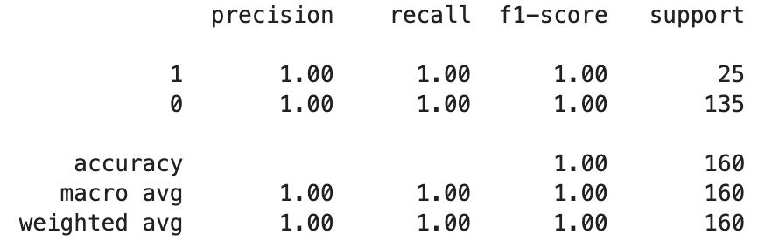
Model 2: Random Forest Classifier
Following the same process as with the SVC, I created a model with no hyperparameters defined. The testing model came out perfect when fitted to the training dataset.

Slide 11
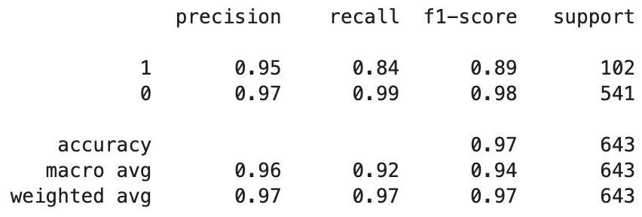
Model 2: Random Forest Classifier
I ran GridSearchCV on precision, accuracy, and recall, but because every training report was 100% perfect, I instead decided to run classification reports on the testing data. Even those were close to flawless.
So to change things up, I decided to intentionally use the *worst* hyperparameters I could find with GridSearch and played around with random states until I landed on this:
Still quite a good model by most measures, but on somewhat more even footing with the SVC. This interested me because I wanted to see how many players the two models would classify differently.

Slide 12
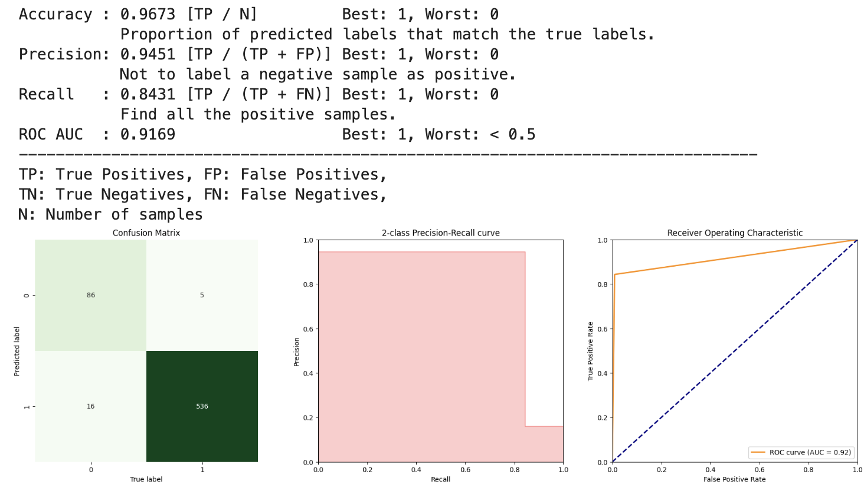
Model 2: Random Forest Classifier
Test summary report
86 true positives
5 false positives
16 false negatives
536 true negatives
Overfitting strikes again. But ironically this is what I wanted.

Slide 13
Binary models: how do players compare?
Out of 803 total players, the two models agreed on 734 players (93 true positives, 5 false positives, 12 false negatives, and 624 true negatives).
Four of the players listed above are among the seven who have hit 500 home runs but have connections to steroids.
Out of the eight controversial players we discussed earlier, four (Bonds, Rose, McGwire, Sosa), were correctly classified by the RFC as true negatives, despite being false positives in the SVC. I found this fascinating because the dataset and models aren’t able account for external factors like gambling or steroid scandals.

Slide 14
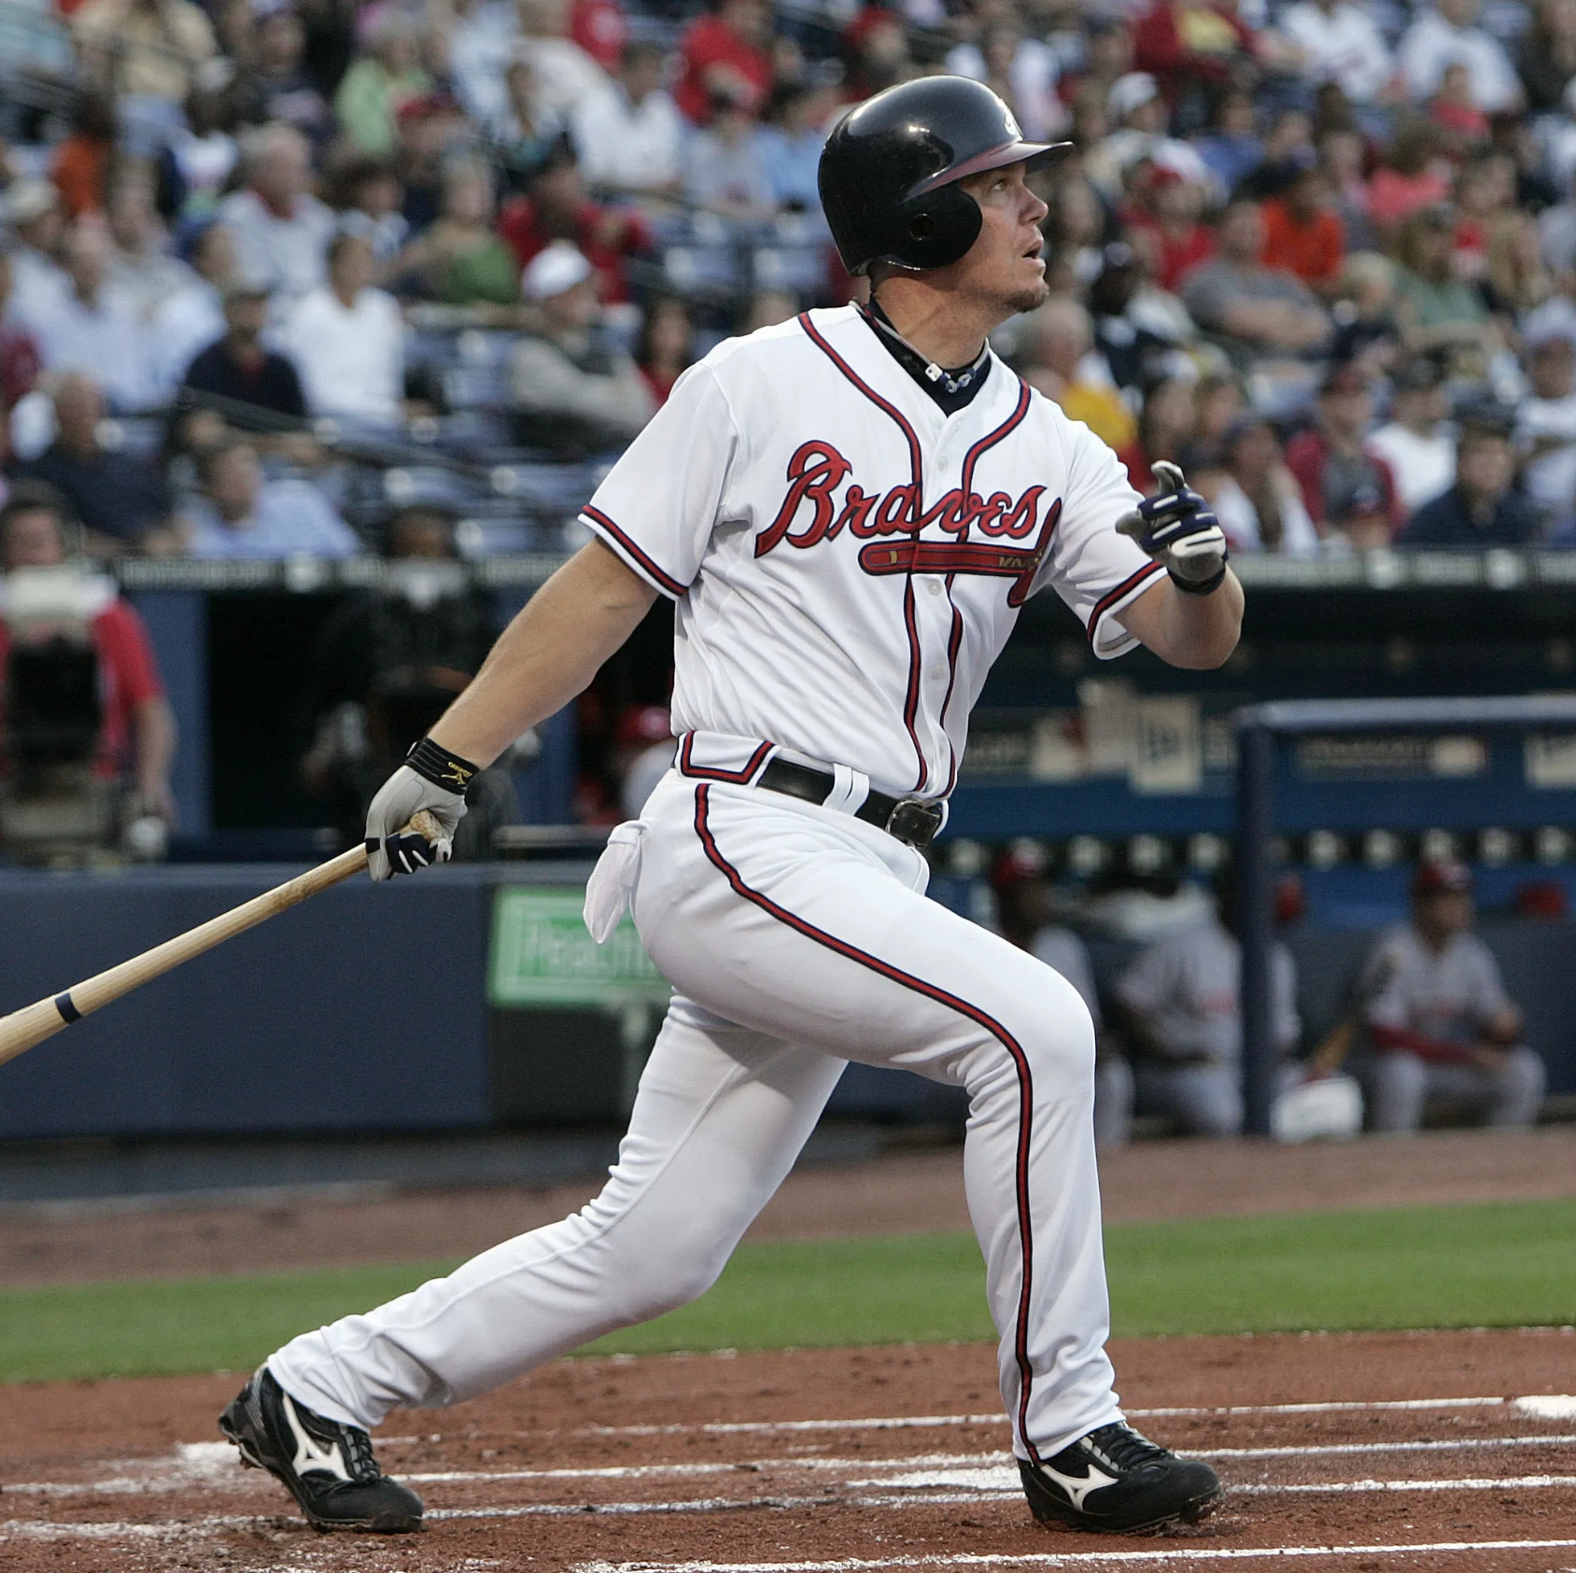
Part 2: Continuous classification
Using a linear regression continuous classification model, how accurately can we predict players’ batting average?

Slide 15
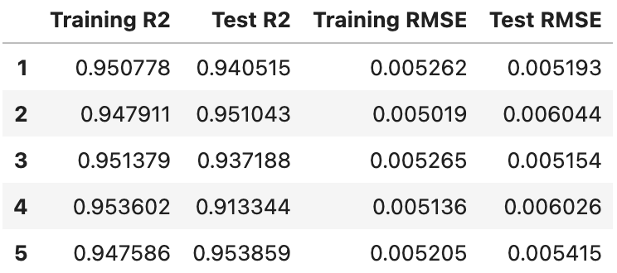
Model 3: Linear Regression
When I initially ran the model using all columns (except ‘BA’) as features, it returned the following statistics.
Intercept: 0.08072644657809427
Training score: 0.955047775942637
Testing score: 0.9331468133360155
Mean squared error: 2.6849619263997452e-05
I also ran K-Folds and got the following:
I was very surprised to see such high numbers right off the bat.

Slide 16
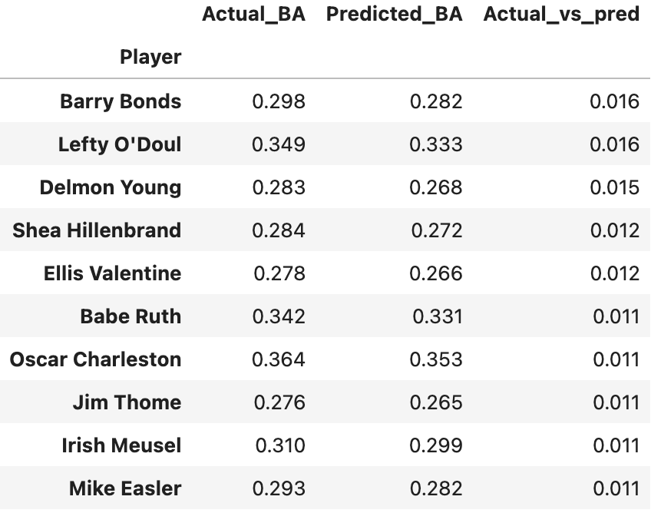
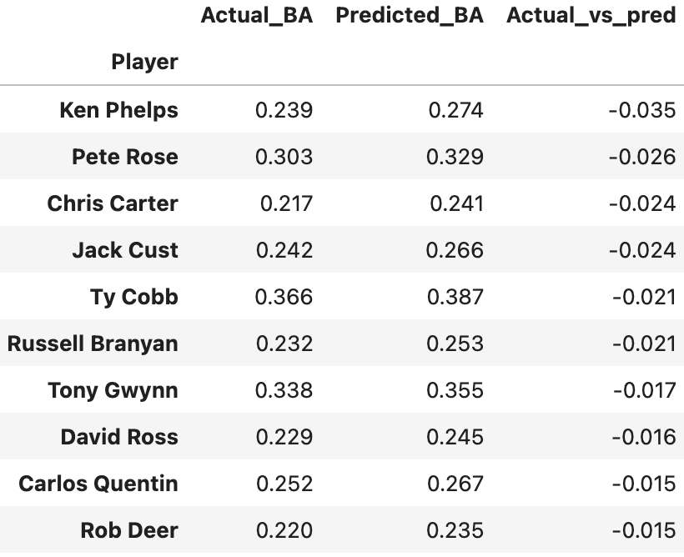
Model 3: Linear Regression
Biggest misses
The 10 players whose batting averages were most underestimated.
The 10 players whose batting averages were most overestimated.

Slide 17
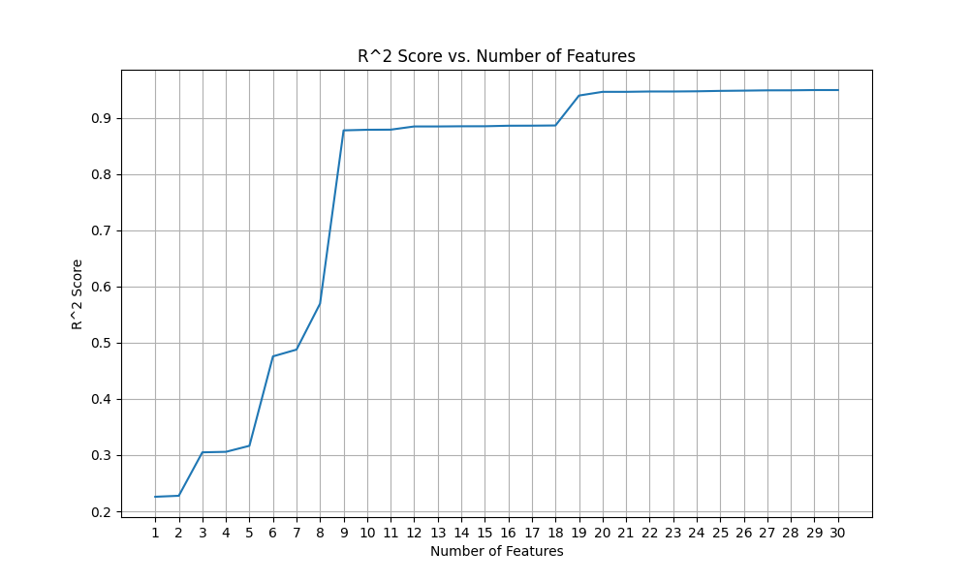
Model 3: Linear Regression
Feature engineering?
Even though my model was great from the jump, I wondered if I could do even better. Sometimes inclusion of more features confuses a model. I wondered if that would be the case here, so I charted R^2 scores by number of features. Turns out, there are no peaks and valleys here - the more the better. However, there is a leveling off around 20 with diminishing returns after.

Slide 18
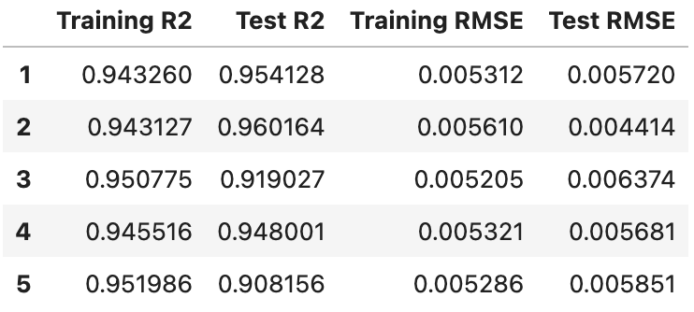
Model 3: Linear Regression
I ran a function to find best features, with a limit of 20, and it returned the following:
OBP, 3B, BB, H, PA, OPS, SO, TB, CS, IBB, HBP, OPS+, SB, SH, Ret_age
With these features selected, I created a new version of the model. It gave the following statistics and K-Folds.
Intercept: 0.00406223
Training score: 0.9535860459479915
Testing score: 0.9312131235980431
Mean squared error: 2.7722699398428993e-05
An extremely small dropoff from the original, but a dropoff nonetheless.

